Slide 1
Chemistry 115
Cary Willard
Office 30-224
Phone 644-7427
E-mail cary.willard@gcccd.edu
Web page www.grossmont.edu/cwillard

Slide 2
Class
MW 12:30 – 1:45 pm
Lab
M 2:00 - 4:50 pm
T 11:00 – 1:50 pm
or Th 11:00 – 1:50 pm
Office Hours – see web page

Slide 3
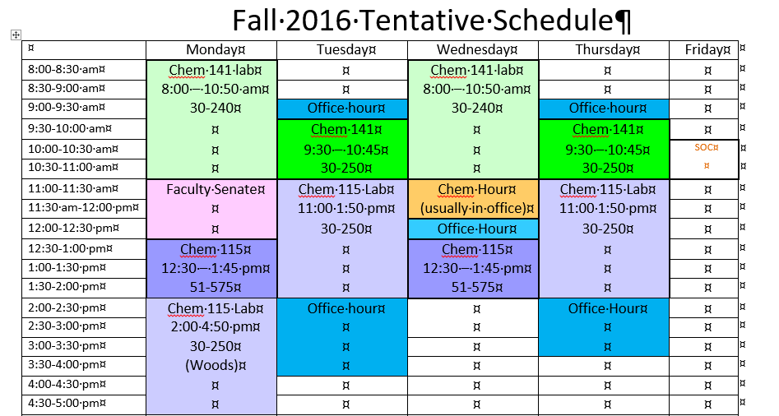
Tentative Schedule

Slide 4
All Course documents will be on either my web page
www.grossmont.edu/cwillard
Or blackboard

Slide 5
This course is designed for health science majors and those wishing a 1 semester lab course for general education.
This course is not intended for any one planning to take general chemistry (141-142).
Physical science, biology, engineering and premed need general chemistry

Slide 6
Prerequisite
Math 90 or high school algebra

Slide 7
Text Foundations of College Chemistry, Hein, 15th edition
Wiley Plus– online homework
Lab Manual Chemistry 115 Lab Manual
Web Sites
http://www.grossmont.edu/cwillard
https://gcccd.blackboard.com/
Optional
Study Guide for above text
Solutions Manual for above text

Slide 8
Additional Requirements
Calculator: Capable of scientific notation (may not be shared during exams).
Safety Glasses: Z-87 Safety goggles (purchased in bookstore),
Ink Pen (for laboratory write-up)
Combination Lock: (purchase from hardware store or bookstore)

Slide 9
Student Learning Outcomes:
This course is both a lecture and a lab course. Our major goals for the semester are to become fluent in the language of chemistry and to utilize the tools of chemistry to analyze a variety of chemical phenomena. We will also explore the behavior of materials in the laboratory and use our knowledge of chemistry to explain that behavior.
In particular, each student will be able to do the following upon completion of this course:
Demonstrate a working knowledge of the language of chemistry.
Apply quantitative reasoning to chemical problems
Apply a laws and theories to explain and predict the properties of atoms and molecules.
Employ laboratory equipment and techniques to collect, organize and evaluate experimental data.

Slide 10
Objectives (from Course Outline)
The student will:
Identify, categorize, and name a variety of chemical compounds based upon their chemical formula.
Write, balance, and interpret chemical and nuclear equations.
Analyze problems to identify data, unknown value, and determine an appropriate method of solution.
Utilize unit dimensional analysis to solve a variety of chemical conversion problems.
Describe atomic structure, periodicity and molecular structure in terms of subatomic particles.
Utilize kinetic molecular theory to write explanations of chemical phenomena in molecular terms.
Perform and analyze chemical experiments in the laboratory.

Slide 11
Grading
Exams 35%
Laboratory Reports 25%
Quizzes 15%
Homework, Computer Drills 15%
Orion 5%
End of Chapter Problems 10%
Final Exam 10%
Total 100%

Slide 12
Grading Scale
A 88%
B 78%
C 67%
D 55%
Must pass both lab and lecture to pass course!
Course grade will be no more than 1 letter grade higher than Exam and Quiz average.

Slide 13
Make-up Policy
Quizzes - No make up allowed. Lowest quiz will be dropped.
Exams - Must be make up within 1 week of original test date. (With a reasonable, verifiable excuse).
Labs – Must be made up within 1 week. No more than 2 labs may be made up during a semester.

Slide 14
Late Work
Labs - lose 20% per week late. No labs accepted more than 2 weeks late.
WileyPlus due on dates given on computer.

Slide 15
Attendance
Regular attendance is mandatory - you may be dropped if you miss more than 6 hours of class (1 week).
You will not be dropped if you have not checked out of the laboratory! This means you will receive an F!!!!

Slide 16
Academic Integrity Policy
All work must be your own!
Calculators will not contain cheat sheets!
Grossmont College Academic Integrity Policy
Cheating and plagiarism (using as one's own ideas writings, materials, or images of someone else without acknowledgement or permission) can result in any one of a variety of sanctions. Such penalties may range from an adjusted grade on the particular exam, paper, project, or assignment (all of which may lead to a failing grade in the course) to, under certain conditions, suspension or expulsion from a class, program or the college. For further clarification and information on these issues, please consult with your instructor or contact the office of the Associate Dean of Student Affairs.

Slide 17
Disabled Students
Students with disabilities who may need accommodations in this class are encouraged to notify the instructor and contact Disabled Student Programs & Services (DSPS) early in the semester so that reasonable accommodations may be implemented as soon as possible. Students may contact DSP&S in person in Room 60-120 or by telephone at (619) 644-7112 or (619) 644-7119 (TTY for deaf).

Slide 18
Supervised Tutoring Referral
Students are referred to enroll in the following supervised tutoring courses if the service indicated will assist them in achieving or reinforcing the learning objectives of this course:
IDS 198, Supervised Tutoring to receive tutoring in general computer applications in the Tech Mall;
English 198W, Supervised Tutoring for assistance in the English Writing Center (Room 70-119); and/or
IDS 198T, Supervised Tutoring to receive one-on-one tutoring in academic subjects in the Tutoring Center (Room 70-229, 644-7387).
To add any of these courses, students may obtain Add Codes at the Information/Registration Desk in the Tech Mall.
All Supervised Tutoring courses are non-credit/non-fee. However, when a student registers for a supervised tutoring course, and has no other classes, the student will be charged the usual health fee.

Slide 19
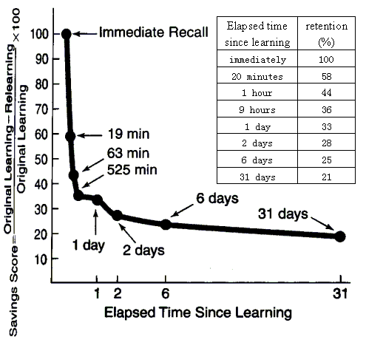
You Can Beat the Forgetting Curve!
*Notice how only ~20 minutes after lecture a typical student loses 40% of what he or she learned during lecture!
*Block out time after every lecture to review and annotate your notes, look over figures in the book, and do a study guide question or two. Block out time later that day, the next day, and at least once a week to do more review.
*Each time you review you will be amazed at how much easier it is to remember everything, even as you add more information with each review.
It IS possible to become more intelligent over the semester- the more you learn and train your brain to learn the better your neuron connections are…which makes you more intelligent.
Learning will become easier in the future!
You just have to practice consistently to see the results.

